Slide 1

A Vista
of
SAG – sustainability action guidance LLP

Slide 2
SAG – sustainability action guidance LLP
About the Company
  SAG is an Environmental Consultant
  It is Limited Liability Partnership Company, came into being recently
  Right now two full time directors are working. Three more are likely to join soon
  SAG Engaged with Highly Experienced and International Professionals
Offerings
  Corporate Sustainability Reporting/ ESG Reporting – based on GRI standards or any other standards
  Climate Change Disclosures/ Carbon Credit Assessments/ Carbon Foot printing
  Water Audit/ Customer Audit (EHS Audit) for Chemical and Pharmaceutical Industries
  Environmental Status Reports for states/ cities
  Environmental Policy Related Studies

Slide 3
SAG – Offerings
Corporate Sustainability Reporting/ ESG Reporting – based on GRI standards or any other standards
  An effort to systematically and voluntarily disclose an organisation’s activities, commitments, targets and their fulfilment towards environmental, social and governance issues; based on a recognised framework and standards
Climate Change Disclosures/ Carbon Credit Assessments/ Carbon Foot printing
  Main frameworks for climate change disclosures are from TCFD (Taskforce on Climate-related Financial Disclosures) and CDP (Carbon Disclosure Project).
Water Audit/ Customer Audit (EHS Audit) for Chemical and Pharmaceutical Industries
A Water Audit is a “Systematic Approach of Identifying, Measuring, Monitoring and Reducing the Water Consumption by various uses.
Customer Audit (EHS Audit) is a systematic, objective tool to assess regulatory compliance in the workplace, and is key for EHS management system.
Environmental Status Reports for states/ cities
Environmental Policy Related Studies
  Strategic Environment and Social assessment (SESA), District/ state Development Programs, Environmental Component of Business Plans for large organisations, Development of environmental indicators, environmental vision documents, etc.

Slide 4
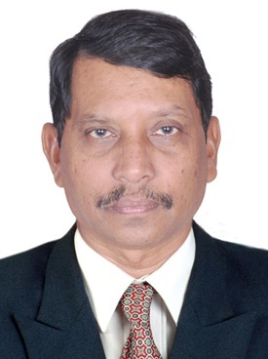
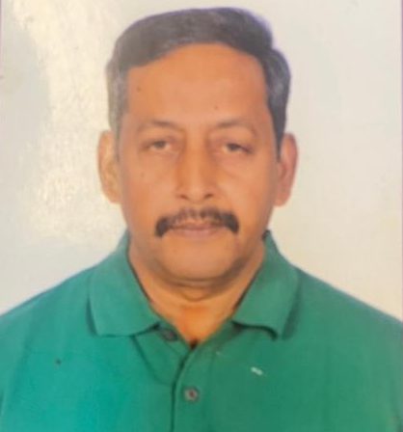
Key Resources
DR D J RAO: He is doctorate in Environmental science. He attended training programs on Sustainability Reporting and Climate Change. He is certified Sustainability Reporting consultant, certified by GRI. Other important trainings attended - Climate Science and Policy by IDP in climate studies (online) - IIT Bombay (10 days each in 2020 and 2021); Corporate Sustainability - Understanding and Seizing the Strategic Opportunity, Bocconi University and SDA Bocconi School of Management, Milan – Italy; and others.
He has over 30 years of post Ph.D of experience in environment, tourism and management consultancy. He was in leadership roles in environmental, tourism, management consultancy and IT delivery sectors.
His expertise includes Sustainability Reporting, Climate Change, Environmental Research, Environmental Policy Analysis, EIA and ESA, Environmental Audit, Tourism Planning and Implementation, Feasibility Studies, Program Monitoring, etc. He conducted over 30 projects in environmental field, 10 projects in tourism sector, program monitoring, etc.
He worked as Project-based Consultant with PWC in environment projects (2015 – 2017) and in leadership position in TCS for over 22 years. He was Group Leader for Environment and Tourism Business for over 10 years and delivery in-charge for two years for Mumbai-based Government IT projects. He has published/ presented various technical papers.
He has working experience in India, Ethiopia, Bangladesh, and Bhutan. He has extensively involved in projects funded by multilateral funding agencies such as the World Bank, ADB, JICA, IFC, and AfDB; and central and state governments.
Dr N Krishna Prakasam: He is Doctorate in Environmental Chemistry, PG Diploma holder in Environmental Studies and did two-year course in Environmental Management. He has 37 years of professional experience in promoting speciality chemicals used in wastewater treatment and industrial processes, hazardous waste management; quality audits, developing new process concepts, process control analysis for finished goods, setting up production targets and monitoring, and implementing major cost saving strategies; process modifications and enhancing operational efficiency.
He is an excellent communicator. He worked as Technical Consultant for United Mud Chemicals, Mumbai, 2018-20 and Rishabh Chemicals and Minerals, Mumbai, 2017-18; Facility Manager in SAR-CHANDRA Environment Solutions (HW Management), Kakinada, 2015-17.
Consultant for 3F Chemical and KEMIRA, 2013-15; DGM Plant Operations and Business Development in Ramki Hazardous Waste Management, Chennai 2012-13; Technical service and Production Quality- SNF India Pvt Ltd, Hyderabad, 2002-11; Environmental Chemist in Hindustan Zinc Ltd, Visakhapatnam, 1985-2001.
His research activities include application and production research in one of the speciality chemical plant in France; application research with acrylic acid base dispersants and acryl amide base Polymers in Johannesburg-South Africa, and Zambia. Attended business conferences in Manila-Philippines and Bangkok-Thailand for understanding South East Asia Business Potential in Various segments w.r.t Speciality chemicals.
He has working experience in India, France, South Africa, Philippines and Thailand.

Slide 5
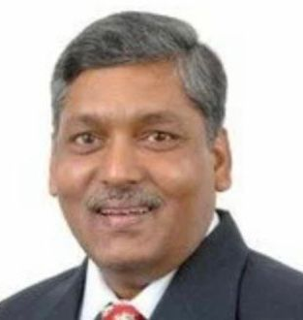
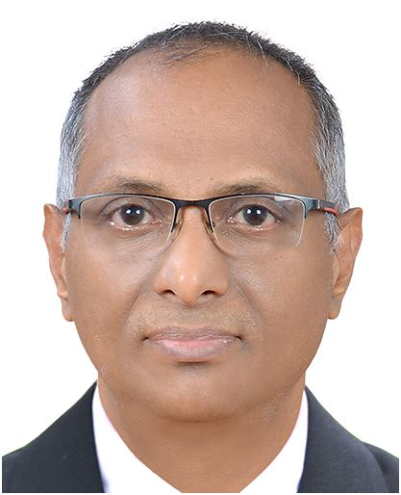
Key Resources (cont’d)
Dr T N V Venkateswara Rao: He is Ph.D holder in Environmental Chemistry and MBA in Operations Management. Associated with CII Environment committee for 5 years and presently associated with BIS as Standards Development committee member (FAD 30). He has participated in GLP (Global Leadership Program) at China, USA & Japan. He has conducted several training programs on water testing, treatment, etc.
He has 33 years (post Ph.D) of professional experience. He is authority on water sector in India as well as international. His main areas of expertise include Water Audit; Ground- and Surface-Water, and Effluent Quality studies;
Raw Water Treatment, Effluent Treatment, and Reuse Technologies; International Standards and Certification of products. regulatory research related to water purifiers, Development of -Quality Systems for the manufacture of Flavours and Fragrances, -new technologies for water purification including nano technologies, -water purifier’s evaluation procedure, -RO purifier standard; ETP performance assessment, etc.
He is Consultant to various multinational organizations from 2014. He was Head of Water business in Asia for Underwriters Laboratories (a US based organization), Oct 2008 to June 2014; Head of Quality and Regulatory Affairs at Givaudan (a multinational company), Feb 2006 to Nov 2008; Headed a world class Water Testing and Research Laboratory in Eureka Forbes Ltd., Aug 1998 to Feb 2006; Executive Manager – QA in Chemplast, Mar 1995 to July 1998; R&D Executive in Eureka Forbes Ltd., Oct 1991 to Feb 1995. He has working experience with international organisations, certification agencies, NGOs, local public, etc. He has working experience in India, The United States, South Africa, Israel, China, South Korea, and Canada.
Dr N D Sen: He is doctorate in Environmental Sciences from JNU, Delhi. He has over 30 years of experience in environmental consulting and IT solutions. His Environmental Consulting expertise includes finding solutions using boundary layer dynamics in diffusion & Transportation of pollutants, mathematical modelling, policy research, air and noise modelling studies, EIAs (large power plants, roads, bridges, inland waterways, and industries), technical assistance projects of multilateral funding agencies (setting of environmental and social screening procedures to ADB for Taj Mahal area (Agra) environmental improvement program including Solid Waste Management). He developed software application for Air quality modelling and monitoring application for Tamil Nadu Electricity Board (TNEB).
He has vast experience in providing IT solutions to Ports and Shipping, and logistic industry in multiple geographies. Instrumental in anchoring many Concept-to-Commissioning projects spanning multiple countries. He was involved in Project Financial Management System (PFMS) for Kerala State Transport Project (KSTP) funded by World Bank. Directed a global end user training program for large continental shipping line company operated in 60 countries and multiple languages.
He was in AIC Watson (Indian arm of Montgomery Watson, UK) in 1995 and worked in Bombay Urban Transport Projects (BUTP II) and in TCS during 1995 to 2022. During this period, he has handled many roles and responsibilities including Solution and Delivery head of Logistic business unit, APAC. He has working experience in Unite Kingdom, other European Countries, Singapore, Hongkong, The United States, South Africa, Israel, China, South Korea, and Canada.

Slide 6
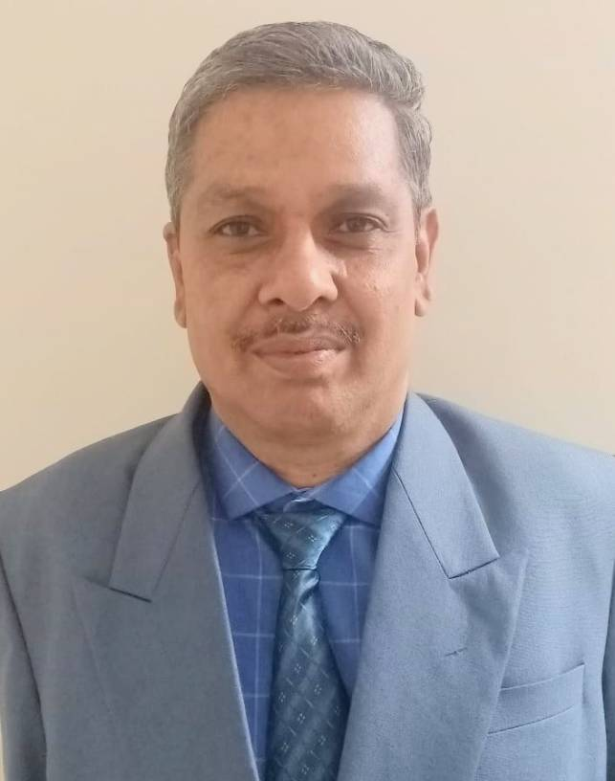
Key Resources (cont’d)
Dr B N Murthy: He is Doctorate in Environmental Chemistry and Diploma holder in Industrial Safety. He is Qualified Lead Auditor for ISO 14001 Certification. He attended training programs in India and abroad (Sweden – Stockholm and Gothenburg; Japan – Tokyo and Sri Lanka – Colombo). He has published several technical papers in peer reviewed international journals and presented various papers in Indian and international seminars/ workshops.
He has 27 years of experience (post Ph.D) in Sustainability Reporting, Environment Audits as part of (EHSS) and implementation, solid and hazardous waste management, ETP performance assessment, EIA, and Environmental Planning.
He has carried out projects on end-to-end Environmental Management Systems; water quality and air quality monitoring and assessment in residential and industrial regions; preparation of zoning atlas; hazardous waste characterisation, quantification and disposal. He has conducted several environmental training programs.
He contributed to industries and research institutes - Associate Vice President: Aurobindo Pharma Limited, February 2010 to May 2022, as In-charge of Environmental Management Systems as part of EHSS Department; AGM-EHS: Matrix Laboratories Limited, Dec 2005 to Jan 2010; and Scientist B: Environment Protection Training and Research Institute (EPTRI), Hyderabad, May 1994 to Nov 2005.
He has working experience with government agencies, industries, NGOs, multilateral funding agencies such as the World Bank, and international consultants. He has working experience in India, Japan, Sweden and Sri Lanka.

Slide 7
Representative Projects Carried out by SAG Resources
SUSTAINABILITY REPORTING: Involved in preparation of sustainability report of 2020-21 for a large pharma company. Sustainability report has been prepared following core option of Global Reporting Initiative (GRI) standards. Information has been collected for economic, governance, environmental and social performance of the organisation. Data collected through questionnaire and interviews with internal as well as external stakeholders. Field observations were also carried out. Associated in preparation of the report.
KACHCHH TOWARDS SUSTAINABLE DEVELOPMENT (SD) – A CONCEPTUAL PAPER, GUJARAT INDIA: After the Gujarat earthquake of January 2001, to uplift the economic conditions of Kachchh district, central and state governments have declared tax holidays for five years in the district to encourage industrial investments. It was felt that the resources would be affected if industrialisation is not properly planned. The SD is an appropriate approach to deal with this situation. The study includes description of geography, climate, topography, geology, land and soils, water resources, vegetation, agriculture, livestock, wildlife, economy, demography of Kachchh. The ecosystems of Kachchh District have been identified along with problems faced by them. A concept was developed on SD for Kachchh based on IUCN’s and IDRC approach.
EHS AUDITS AND ASSESSMENTS FOR PHARMACEUTICAL AND CHEMICAL SECTOR: An audit has been carried out for M/s Amadalavalasa Co-operative Sugar Mills Limited, Andhra Pradesh. Project was sponsored by Government of AP. Similarly, an environmental audit has been carried out for Asian Paints Limited, Patancheru, Medak Dist., Telangana.
WATER AUDIT FOR ENGINEERING AND CHEMICAL INDUSTRIES: Over 10 water audits were carried out. These audits help to find optimum usage of water and water losses. Reduce, reuse, and recycle have been suggested wherever it is feasible. Practically possible solutions have been suggested to clients.
STANDARDS FOR WATER PURIFICATION SYSTEMS: Contributed to the development of RO water purifier standard (IS 16240). This includes review of existing standard and suggest modifications to BIS. BIS has already finalised the modifications and published the revised standard. Also developed a new standard to BIS for arsenic purification systems of drinking water. The standard is in draft stage at BIS and will be finalised soon.
TAJ MAHAL AREA ENVIRONMENTAL IMPROVEMENT PROGRAM: The program was funded by ADB. Before the Improvement activities taking place, the Bank wanted to assess the background environmental conditions and possible positive outcome of the projects. The Program has many projects like solid waste management, gas pipeline network, water treatment plans, etc. The study was conducted in Agra area covering all the environmental parameters and projected improvements were estimated.
MANUFACTURING PROCESS ANALYSIS AND MODIFICATIONS: In water soluble Polymer manufacturing plant, analysed various processes and recommended process modifications and equipment calibrations to enhance operational efficiency. Ensured complete in-process quality control and continuous improvement in process capabilities. Foreseen performance bottlenecks and taken corrective measures to avoid the same. Associated extensively in establishing Water-soluble Polymers application Labs at Various Industrial Customers in different segments.

Slide 8
Representative Projects Carried out by SAG Resources (cont’d)
STATE ENVIRONMENTAL ACTION PROGRAM (SEAP) FOR GUJARAT - INDUSTRIAL POLLUTION COMPONENT: The study was funded by the World Bank. Gujarat Ecology Commission (GEC) intended to prepare SEAP for eight components, Industrial Pollution as one of the components. This is a three-phase study. Phase I: identification of pollution problems (air pollution, groundwater and surface water pollution, hazardous waste management, urban air pollution, occupational health problems, etc). This Phase also includes prioritisation of problems and preparation of action plans for prioritised problems. In Phase II, alternative solutions, strategies, and action plans for each priority problem were developed. Phase III involves preparation of sectoral report for industrial pollution component in Gujarat combining phase I and Phase II.
AIR QUALITY PREDICTION MODEL DEVELOPMENT AND MAINTENANCE FOR NORTH MADRAS SUPER THERMAL POWER PROJECT (NMTPP): Tamilnadu Electricity Board (TNEB) was developing a super thermal power station with assistance of World Bank. We identified air quality monitoring locations around the power plant complex, developed computer aided air quality model using gaussian diffusion and dilution principle, train the TNEB engineers to use the model and model out-put analysis. This was a capacity augmentation for Board’s environmental management cell.
WEREDA INTEGRATED DEVELOPMENT PLAN (PACKAGE III) IN ETHIOPIA – ENVIRONMENT COMPONENT: The study was funded by African Development Bank (AfDB). Government of Ethiopia was preparing wereda (district) wise development plans. The purpose of this study is to ensure that proposed development is environmentally sound and sustainable, and to early identification of environmental consequences. The Study included issues such as forest degradation, land degradation, use of wood for building construction and cooking, depletion of wildlife, water quality, etc. Identifying projects to deal with the issues, cost estimation and preparation of implementation plan. Study environmental impacts developmental projects (roads, water supply, school buildings, etc), produce bankable reports by considering national and donor’s regulations.
ENVIRONMENTAL AND SOCIAL MANAGEMENT SYSTEM (ESMS) FOR ICICI: ICICI was expecting a line of credit from the World Bank for infrastructure finance. For this purpose, ICICI prepared Environmental and Social Management Systems (ESMS). The study includes review of existing ESA systems and procedures of ICICI; identification of gaps; review of existing project cycle; overview of policies of India, The World Bank and ADB; identify future trends in environmental and R&R issues; formulate ICICI’s environmental and social policy; develop environmental and social rating model and guideline; develop criteria for environmental categorization of projects and develop guidelines for the same; develop screening procedures and guidelines environmental aspects in project financing.
ENVIRONMENTAL INDICATORS FOR THE INDUSTRIAL REGIONS OF GUJARAT: This is the World Bank funded study. Gujarat Institute of Development Research (GIDR) intended to develop suitable environmental indicators for industrial regions of Gujarat. The study involves review of environmental indicators in the industrialised countries, development of desirable and desirable-feasible indicators for Gujarat industrial regions for three components such as air, water, and land environment in the pressure-state-response (PSR) framework of OECD, verification of data availability for these indicators, illustration of desirable-feasible indicators with the data of Vadodara industrial region.

Slide 9
Representative Projects Carried out by SAG Resources (cont’d)
WATER PURIFIER PRODUCT DEVELOPMENT: Water purifiers have been developed using various technologies for point of use applications. The technologies used were ultrafiltration, reverse osmosis, etc in separate products and combined to develop a different product.
STATE OF THE ENVIRONMENT REPORTS FOR COMBINED ANDHRA PRADESH AND HYDERABAD CITY: The projects were sponsored by CPCB. Involved in data collection from various departments, analysis of data and preparation of the reports.
DEVELOPING NEW PROCESS CONCEPTS: New process concepts were developed for production optimization, yield improvement and develop guidelines for the sequencing of manufacturing of water soluble Polymers activities on the shop floor including monitoring the Product quality of the batches produced as per the norms set by standards department.
  By applying appropriate water soluble polymers extended technical service in settling impurities as per the requirement to several Process Industries in highly acidic and highly caustic Oriented slurries in Hindustan Zinc Smelters and NALCO Damanjodi.
  Similarly, by appropriate application of water-soluble Polymers in Essar Group of organisations like Higrade Pellets, 60-75% Bentonite is replaced with 0.015-0.02% water-soluble Polymer in Iron Ore Plants to enhance Iron Value thereby to decrease Alumina and Silica in Iron Ore Pellets during Palletisation Process.
QUANTIFICATION AND CHARACTERIZATION OF SOLID AND HAZARDOUS WASTES: This project was carried out in the Industrial Estates of Hyderabad, Rangareddy and Medak Districts of Telangana.
HAZARDOUS WASTE MANAGEMENT: In ‘Hazardous Waste Management’ plant recovered oil from oil-based mud from oil drilling fields and reused the same as fuel in the same plant. Associated with Various Industrial Segments for controlling Pollution loads by appropriate application of Water-soluble Polymers.
ENVIRONMENTAL IMPACT OF TALA POWER TRANSMISSION LINES: ADB intended to fund the construction of Power Transmission lines from Tala hydroelectric power station in Bhutan to Tata Power grid in India. Before funding, the Bank wants to understand the environment Impact of the project. The impact assessment study carried over the sensitive spots of the power transmitting line cutting across few states in India. The construction impact of air, water, soil, land-use patterns were studied. The study also identified the key indicator to monitor the impacts in operational phase.
Apart from the above, SAG resources carried out over 25 EIA projects.

